Slide 1
DIRECTORATE OF AGRICULTURE, GOVERNMENT OF GOA
Agriculture schemes 2023-24

Slide 2
Krishi Card
Documents required:-
Election card
Adhar card
Affidavit
Land index
Passport size photo
Bank pass book Xerox
Mandate form/cancel cheque
Nominee pass book xerox

Slide 3
Soil Testing

Slide 4
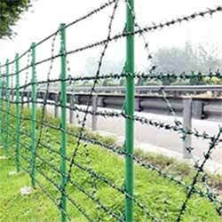
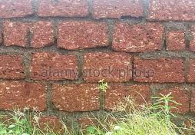
Fencing
Stone wall
Rs. 740/RM
Specification :0.5m Width at base
: 0.25m width
: 1.2m height
Barbed/GI wire fence
Rs.28/mt. for barbed wire with wooden poles.
Rs.32/ mt for barbed wire with RCC poles.
3-7 lines
Wire Mesh/ Chain Link Fence
Standard cost Rs.320/RM for 4 ft height.
Standard cost of Rs. 390/RM for 5 ft height or above
Poles:
Sr. No | Size | MS Poles (Std Cost) per pole | RCC Poles (Std Cost) per pole
1 | 5” | Rs. 365 | Rs. 350
2 | 6” | Rs. 440 | Rs. 400
3 | 7” | Rs. 515 | Rs. 470
75% Gen & 90% ST/SC subsidy

Slide 5
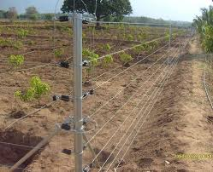
Special fencing for small vegetable grower’s
Plots min.500m²(barbed wire)
Maximum Limit : 2 Lakh /farmer
Solar Power fence
90% subsidy to all farmers

Slide 6
Irrigation

Slide 7
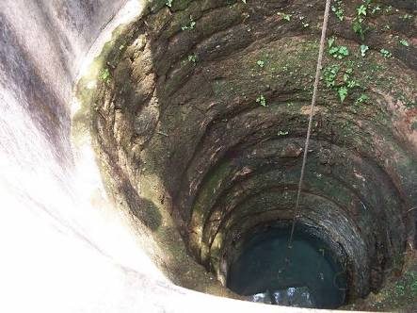
Assistance for digging and construction of irrigation well
Min. 0.125 ha
75 % subsidy
Upto 2 lakh for above 1 ha

Slide 8
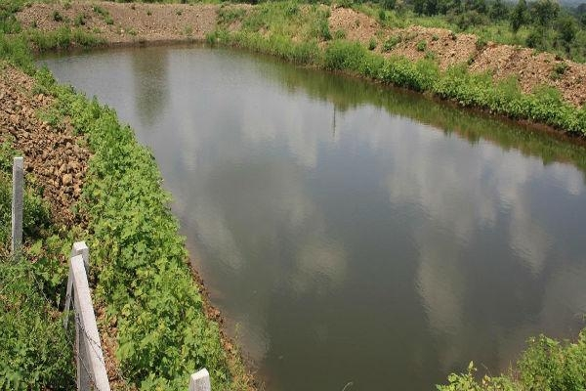
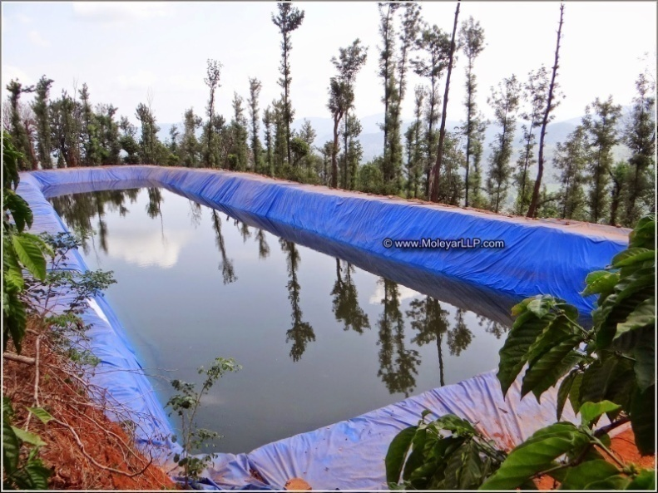
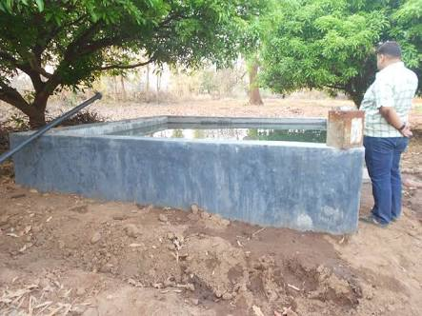
Assistance for Water storage tank/pond
50 % subsidy
Size:15 m3 -100 m3
Rs.1000/- per m3
max. 1 lakh per beneficiary

Slide 9
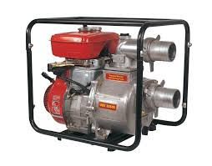
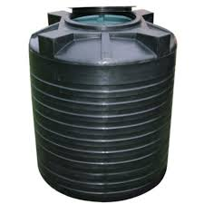
Assistance for HDPE/UPVC Water Storage Tank
Assistance for Installation of irrigation Pumpset
Area – 0.05 to 0.15 Ha.
Max. Capacity – 1000 Ltrs.
Max. Assisitance – 3500/- per unit.
90% subsidy - upto 5hp pump
50% subsidy - above 5hp pump
Replacement - 50 % subsidy

Slide 10
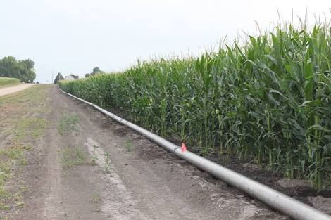
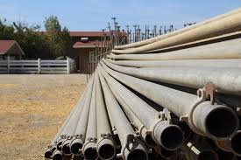
Assistance for installation of conveying pipeline
50% subsidy
Rs.20000/- per ha
Max. 1 lakh per farmer

Slide 11
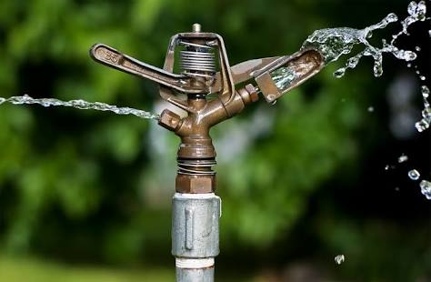
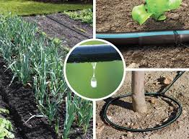
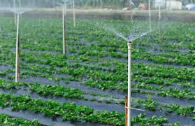
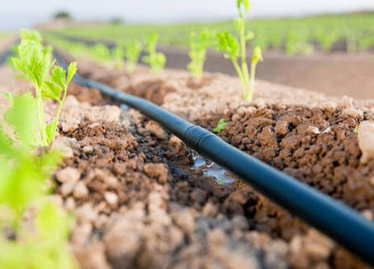
Assistance for installation of sprinkler irrigation system
Assistance for installation of drip irrigation system
75% subsidy
90% subsidy
Min. area of 0.125 ha with 0.1ha. net area under crops.

Slide 12
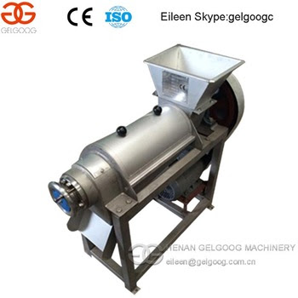
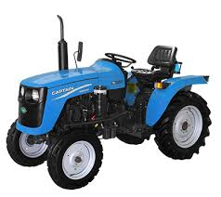
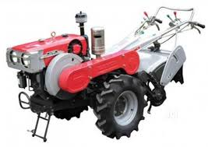
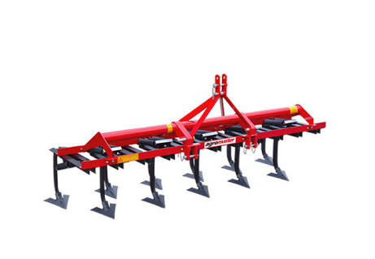
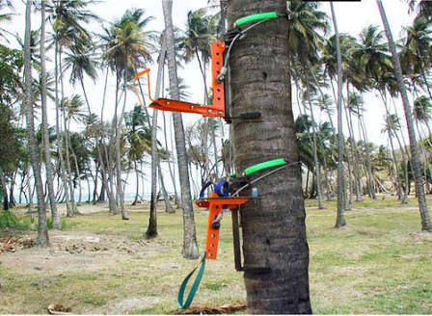
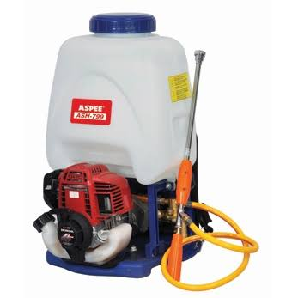
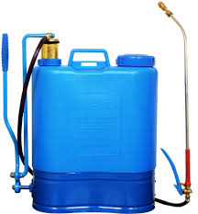
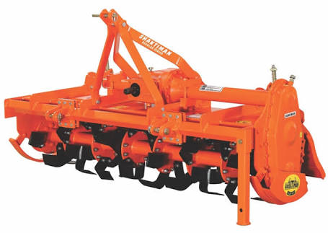
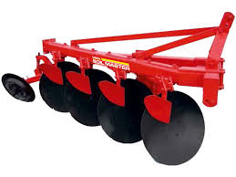
Mechanization
Sr.No. | Type of Machinery | ST | Gen, SC, Group Societies etc)
1 | Tractor, Mini Tractor, Power Tiller & Paddy Combine | 50% | 50%
2 | Mini Tiller | 90% | 50%
3 | Weedcutter | 90% | 75%
4 | Other Agri Machinery | 75% | 75%

Slide 13
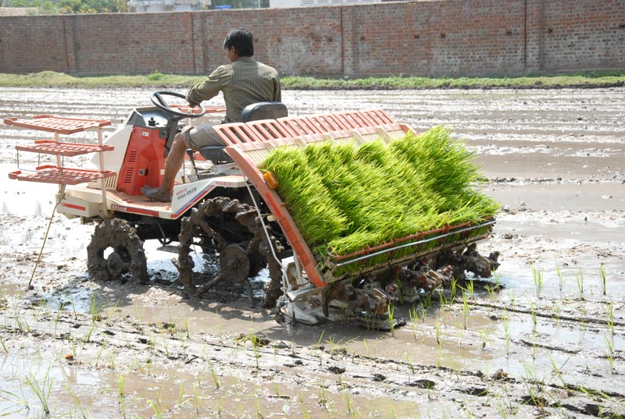
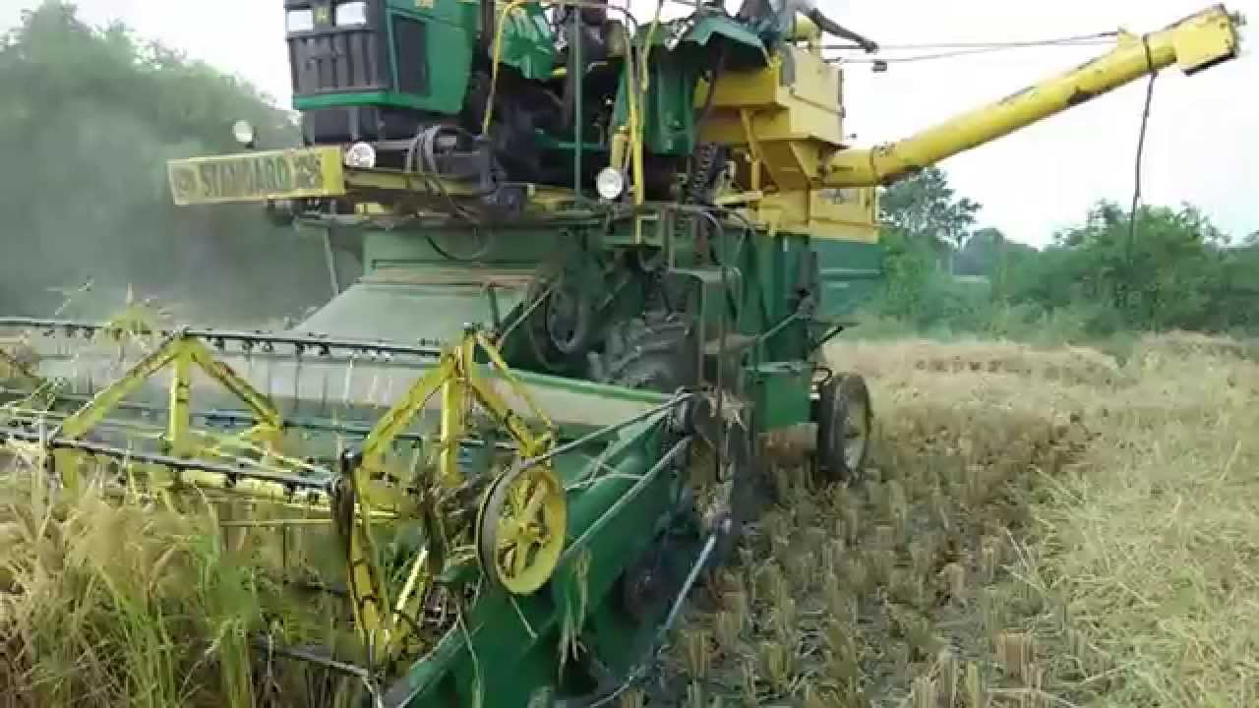
Hiring of Agriculture machinery
50 % subsidy
Transplanting of Paddy
50 % subsidy
Max. Rs.15,000/- per ha (individual)
& Rs.18,000/- per ha (Group)
Harvesting of Paddy
50 % subsidy

Slide 14
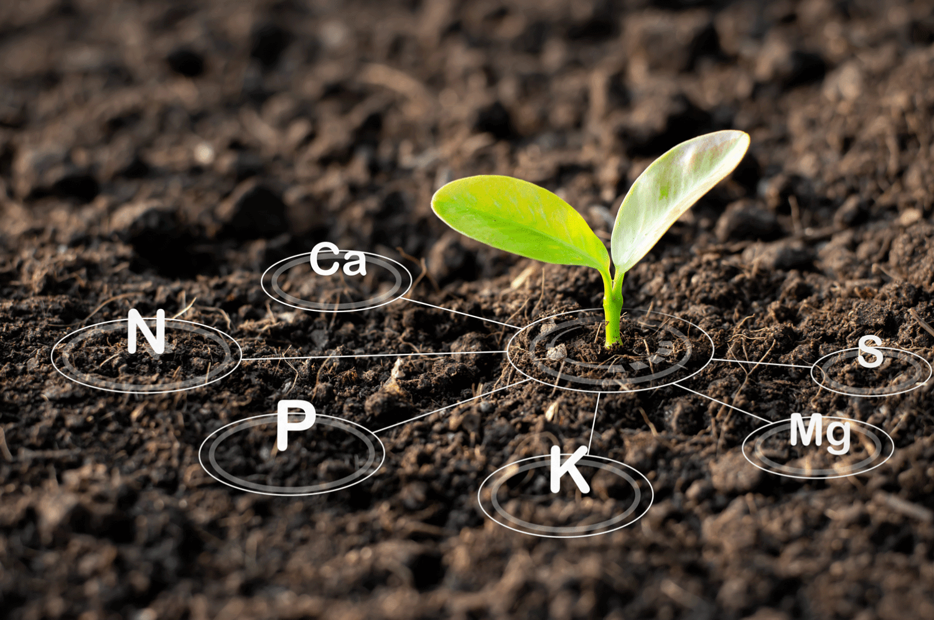
Soil Nutrition

Slide 15
Micronutrients (Zinc, Boron)
Soil conditioner (Rock Phosphate, Lime)
75% subsidy or 7500/- per ha
Max. 4.0 ha
75 % subsidy or Rs.6000/- per ha
Max. 4.0 ha

Slide 16
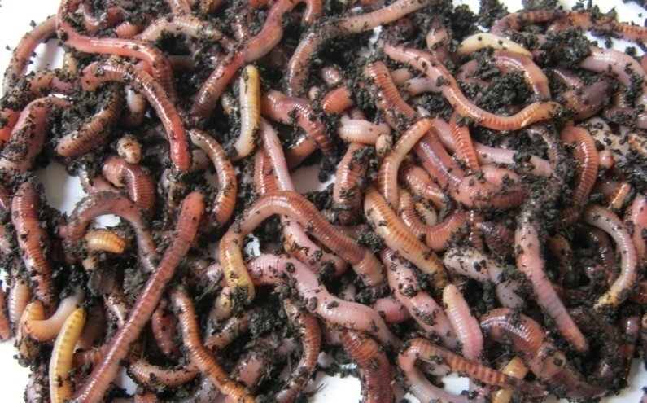
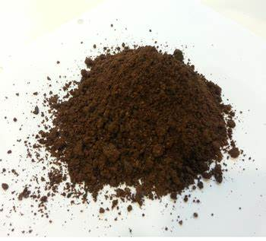
Organic Inputs
50% subsidy or Rs.10000/- per ha
Max. 2 ha
Organic Fertilizer:
Vermicompost, neem cake, mushroom waste, ground nut cake, organic manure of plant origin
Bio-fertilizers:
Rhizobium, Azotobacter, Nitrogen Fixing Biofertilizer, Phosphate Solubilizing Bacteria
Bio-pesticides:
Verticillium, Metarhizium, Trichoderma spp.

Slide 17
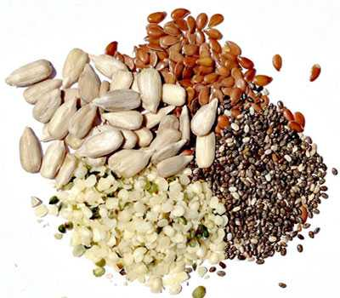
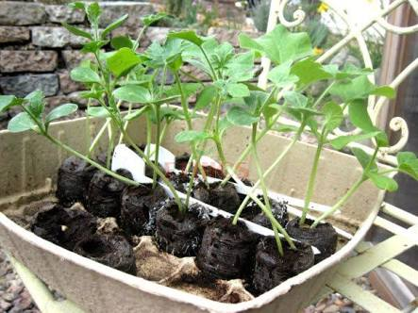
Inputs
Tribal Sub Plan
Seeds, planting materials, pesticides, fertilizers
12000/- ha or 75% subsidy
Max. 2.0 ha

Slide 18
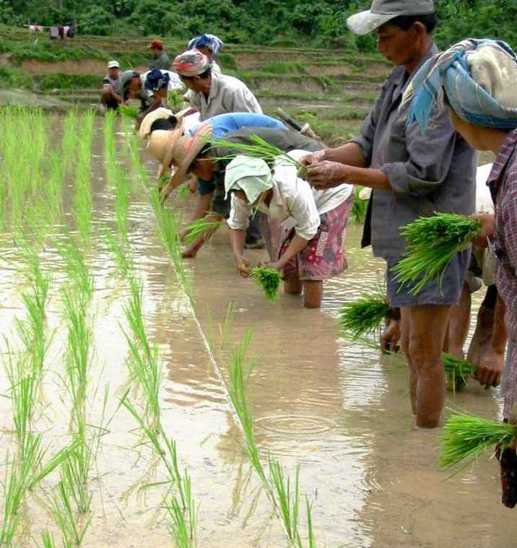
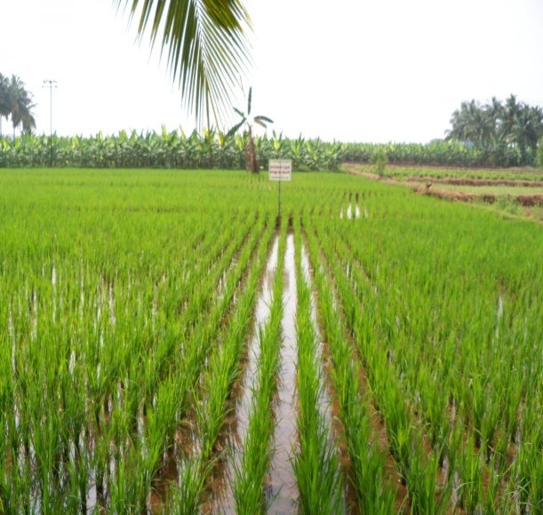
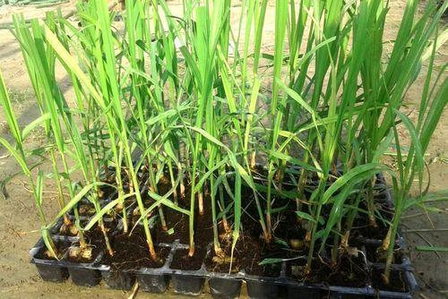
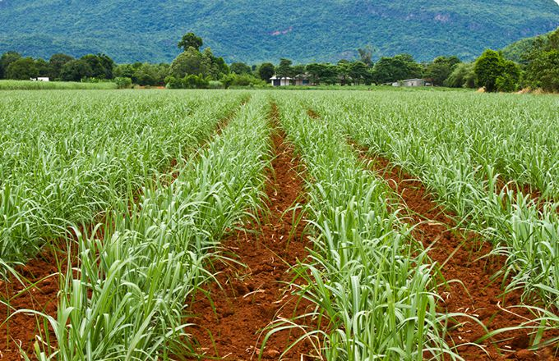
Agronomy
Sugarcane
Seedling
50% of the cost of planting material
Max up to Rs. 22,500/- per ha for sugarcane seedling.
Rs. 15,000/- per ha for purchase of locally available sugarcane seed setts and
Rs. 18750/- per Ha for sugarcane setts procured from neighbouring state
Paddy (Rice)
System of Rice Intensification (SRI)
Rs.10,000/- per ha (Rs.1/- per sq mt)

Slide 19
Horticulture

Slide 20
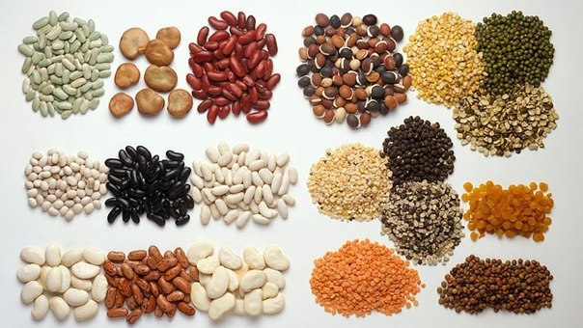
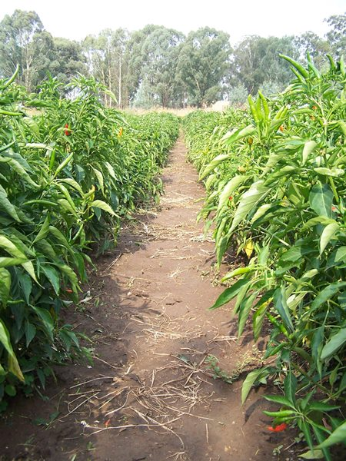
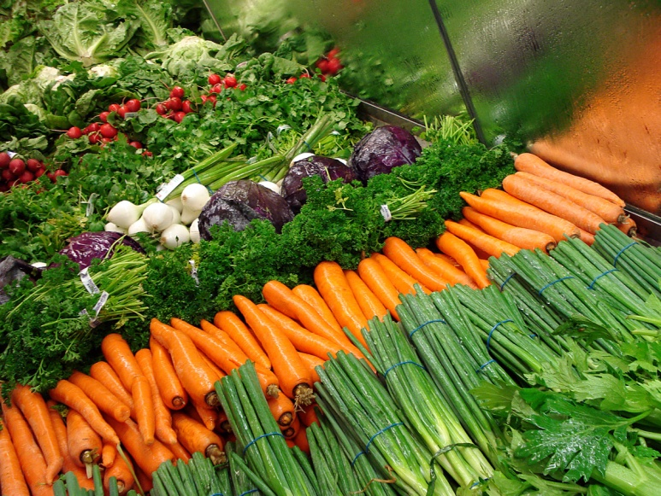
Vegetables
High Yielding Seeds/Hybrid Seeds
50 % subsidy
75% subsidy on vegetable seedlings sold through Departmental outlets.
Cultivation of Vegetables
Rs.80,000/ha
Max 5 ha for SHG’s and 1 ha for individual farmer.

Slide 21
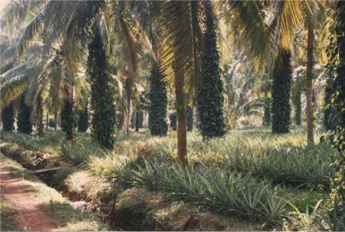
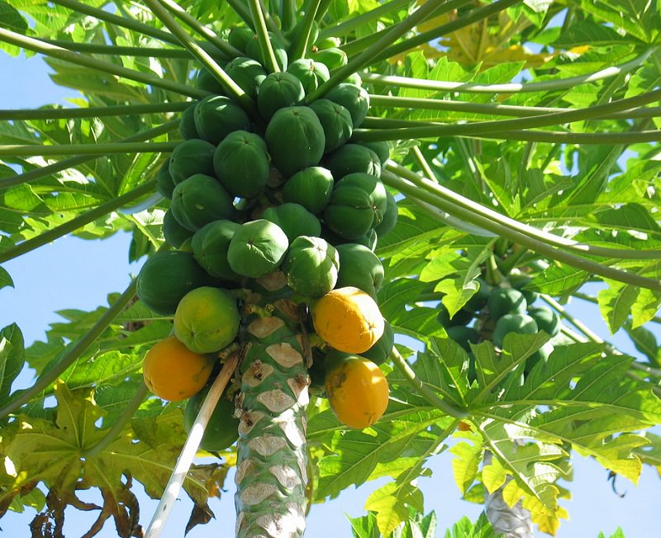
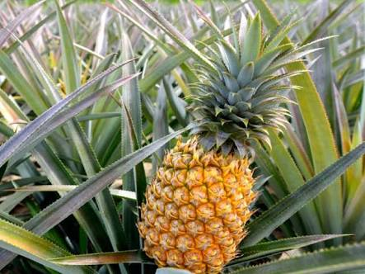
Assistance for cultivation Of fruit plant under NHM and State
Papaya
Rs.1,20,000/- per ha
Max. 4 ha
Other fruit Crops or Spice crop
Rs.60,000/- per ha
Banana
Rs.1,20,000/- per ha
Max . 4 ha
Pineapple
Rs.1,20,000/- per ha
Max. 4 ha

Slide 22
Assistance for cultivation Of Flower under state and NHM
Loose Flowers
75 % subsidy
Rs.75,000/- per ha
(Marigold, Jasmine, Crossandra)
Bulbous Flowers
75 % Subsidy
Rs.1,20,000/- per ha
(Gladiolus, Tuberose, Heliconias)

Slide 23
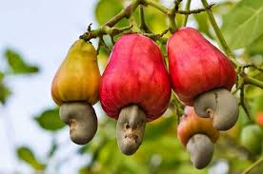
Coconut Development Board
Cultivation of Coconut with local tall varieties.
New area
Rs.60,000/- per ha
Max. Area – 4 Ha.
75% subsidy
Rs.50,000/- per ha
160 palm per ha
Min area 0.1ha and Max 5ha
Replacement
Rs.20,000/- per ha
Max. Area 2 Ha.
Cultivation of Hy. Coconut saplings/Dwarf:
50% subsidy
limited to Rs. 150/- per Hy. Coconut saplings.
Area expansion in cashew

Slide 24
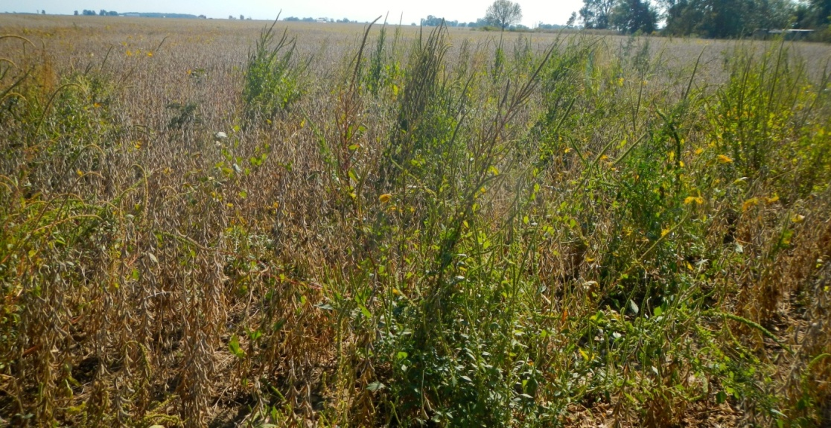
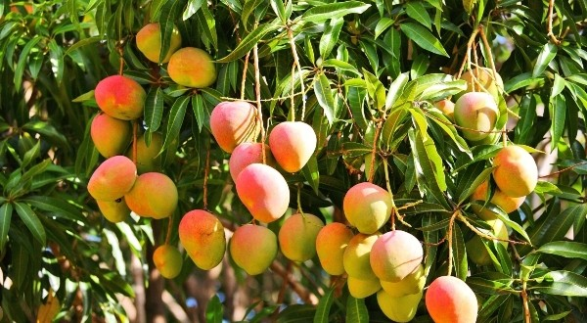
Commercial Mango Orchard
Assistance of max. Rs. 2 lakhs/ha- Rocky Area
Assistance of max. Rs. 1 lakhs/ha – Normal Lateritic Area
Mini. 0.5 Ha. &Max. Upto 5 Ha
50 % Assistance
Max. Rs.15,000/ha
One time assistance for removal of weeds/ bushes/ shrubs/ aquatic weeds.

Slide 25
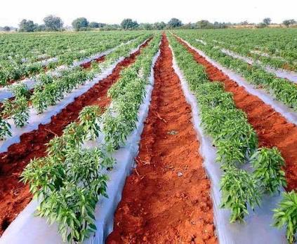
Assistance for Mulching Paper
50 % subsidy or 12,000/- per ha.
Max. area 2.0 ha

Slide 26
Integrated Pest
Management

Slide 27
Weedicides, Pesticides, Fungicides
For Gen: Rs.4500/- per Ha. or 75% subsidy
For ST/SC: Rs.5400/- per Ha. or 90% subsidy
Max. area 4.0 ha

Slide 28
Infrastructure

Slide 29
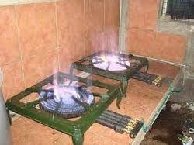
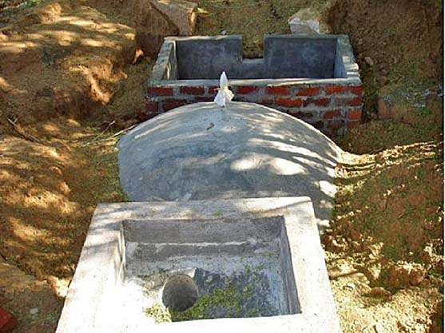
Assistance for Construction of biogas unit
90 % subsidy for New Biogas
50% Subsidy for repair of Old. (Mini 5 yrs old)

Slide 30
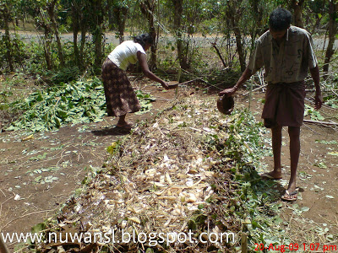
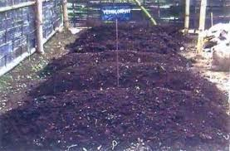
Assistance for organic manure unit
Assistance for vermi-compost unit
75% subsidy or 1950/- per m3
Portable- 90% subsidy
Max. 3 units
Max. 7500/- per farmer

Slide 31
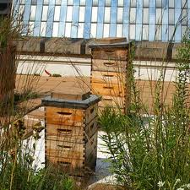
Bee Keeping for honey production
75% Gen
limited to Rs.2.07,
90% for ST & SC.
limited to Rs. 2.48 Lakhs.

Slide 32
Assured price
Paddy – Rs.22/- per kg
Sugarcane – Rs.3000/- per ton
Cashew – Rs.150/Kg
Coconut – Rs.15/- per nut
Alsando- 100/Kg
Oil palm – Rs.9000/- per ton
Assured price of Rs.15/-
Average min. rate will not be less than Rs. 6/-,
Max. Assistance is 50,000 nuts, up to 5 ha. and Min. 500 nuts
Subsidy limit of Rs 3, 00,000/year / farmer.

Slide 33
Shetkari Adhar Nidhi
Compensation to the farmer who suffers losses in agriculture due to Natural calamities
Maximum up to Rs.40,000/- per ha for all crops and for sugarcane Rs.60,000/- per ha
Rs.1,60,000/- per individual farmer per year.

Slide 34
ATMA (Agriculture Technology Management Agency)

Slide 35
Farmers Activities
Training of Farmers
Within district
Within state
Inter state
Demonstration
Exposure Visit
Within district
Within state
Inter state

Slide 36
Community Farming
Two types of groups
a. Joint community farming
b. Loosely Amalgamated community farming.
minimum 10 members with total combined land holding exceeding One hectare (10,000 sq. mtrs) in compact block.
The CFG shall be registered with Directorate of Agriculture Goa./ Societies act 1860. and should possess Group Krishi Card.
CFG is expected to engage in double or triple cropping of field crops.
Assistance for fencing, infrastructure and marketing
Assitance of Rs 2.5 lakhs per ha.

Slide 37
Fertilizer license Pesticide License Pest Control Operator License

Slide 38
International year of Millet
50% subsidy or Rs.20000/- per ha
Max. 2 ha

Slide 39
Mushroom production Mushroom spawn of Pl. florida (Oyster mushroom is produced at Biocontrol laboratory and sold @ Rs 80/kg

Slide 40
NUTRI-CEREALS
Millets are collective group of small seeded annual grasses that are grown as grain crops, primarily on marginal land in dry areas of temperate, sub tropical and tropical regions.
Earliest evidence found in Indus civilization : 3000 BC.
Ancient food grains first plants domesticated for food.
Grown in 131 countries. Millets traditional food for 59 crore people in Asia & Africa.

Slide 42
WHY TO GROW MILLETS?
Millets can be grown almost throughout the year whereas wheat is season specific
Millets provides multiple security-Food, fodder, health, nutrition, livelihood, ecological whereas paddy and wheat only provides food security
It can minimize malnutrition in rain fed areas particularly in tribal areas

Slide 43
Farmers Awards
Krishi Ratna – Rs. 2.00 Lakhs
Krishi Vibhushan – Rs. 1.00 Lakhs
Krishi Bhushan – Rs. 0.50 Lakhs
Best Organic Farmer – Rs. 0.50 Lakhs

Slide 44
CARRIERS IN AGRICULTURE
COLLAGE OF Agriculture at Ela, old-Goa Complex
Four year degree course
Sixty students per batch

Slide 45
Other facilities
NOC to obtain electricity connection (LTAG)
Status report of agriculture trees as per the dirctived of Dy.Collector.

Slide 46
“Pradhan Mantri KIsan SAmman Nidhi (PM-KISAN)”
Farmer families shall be provided a benefit of Rs.6000 per annum per family payable in three equal installments, every four months.

Slide 47
Exclusions
The following categories of beneficiaries of higher economic status shall not be eligible for benefit under the scheme:
All Institutional Land holders; and
Farmer families in which one or more of its members belong to following categories
Former and present holders of constitutional posts
Former and present Ministers/ State Ministers and former/present Members of Lok Sabha/ Rajya Sabha/ State Legislative Assemblies/ State Legislative Councils, former and present Mayors of Municipal Corporations, former and present Chairpersons of District Panchayats.
All serving or retired officers and employees of Central/ State Government Ministries /Offices/Departments and its field units Central or State PSEs and Attached offices /Autonomous Institutions under Government as well as regular employees of the Local Bodies (Excluding Multi Tasking Staff / Class IV/Group D employees)
All superannuated/retired pensioners whose monthly pension is Rs.10,000/-or more(Excluding Multi Tasking Staff / Class IV/Group D employees) of above category 2.4.1
All Persons who paid Income Tax in last assessment year.
Professionals like Doctors, Engineers, Lawyers, Chartered Accountants, and Architects registered with Professional bodies and carrying out profession by undertaking practices.

Slide 48
For more information
DIRECTORATE OF AGRICULTURE
KRISHI BHAVAN, TONCA, CARANZALEM-GOA
PHONE:- (0832)2465845/2465443
email:- dir-agri.goa@nic.in Website:-www.agri.goa.gov.in
Also contact your
Zonal Agriculture Offices:-Schemes & Technical guidence
Mechanical Cultivation Offices:-Machinary
Govt. farms:- Quality planting material

Slide 49
THANK YOU

