Slide 1




DIRECTORATE OF FISHERIES PANAJI- GOA

Slide 2




PRADHAN MANTRI
MATSYA SAMPADA YOJANA

Slide 3
PRADHAN MANTRI MATSYA SAMPADA YOJANA (PMMSY)
The Government of India approved the “Pradhan Mantri Matsya Sampada Yojana (PMMSY) – A scheme to bring about Blue Revolution through sustainable and responsible development of fisheries sector in India
Designed to address critical gaps in fish production and productivity, quality, technology, post-harvest infrastructure and management, modernisation and strengthening of value chain, traceability, establishing a robust fisheries management framework and fishers‟ welfare
PMMSY is a part of Atmanirbhar Bharat Package
Implementation Period: 5 years (2020-21 - 2024-25) in all States/Union Territories

Slide 4
FUNDING PATTERN
Centrally Sponsored Scheme (CSS) Component:
  Non-Beneficiary oriented activities –Centre 60% and State 40% of the total project cost
  Beneficiary orientated activities : –
        Governmental Assistance ( Center + State) :
          General Category - 40% of the project cost
          SC/ST/Women - 60% of the project cost
        The Governmental Assistance will be shared between Center and States as below
        60:40 General States
        Governmental assistance (center+ state) for the activity livelihood support for fishers during ban/lean period would continue as per existing Blue Revolution Scheme shared in the ratio of 50:50

Slide 5
Entrepreneurship Development and Employment Generation

Slide 6
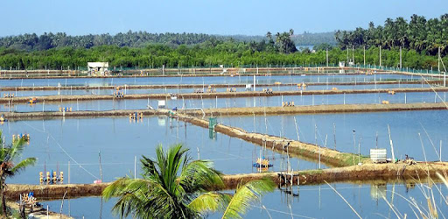
Scheme | Amount/nature of support provided
Name of Scheme | Units (No./ Ha.) | unit Cost (Rs.) | General (40% financial assistance) | ST/SC/Women (60% financial assistance)
Construction of new ponds for brackish water aquaculture | 2 ha. | 8 lakhs/ ha | 3.20 lakhs | 4.80 lakhs
Input cost for brackish water aquaculture | 2 ha. | 6 lakhs/ ha | 2.40 lakhs | 3.60 lakhs
Documents Required 15 years Residence Certificate of applicant CAA Registration Certificate Aadhaar Card SC/ST Certificate (if applicable) Detailed Project Report Quotation/ Cost Estimates Work completion certificate from the registered Engineer Mandate form (2 copies)

Slide 7
Scheme | Amount/nature of support provided
 | General | ST/SC/Women
Construction of New Grow-out ponds for Fresh water | Financial assistance of 40% will be granted limited to unit cost of Rs. 7 lakhs | Financial assistance of 60% will be granted limited to unit cost of Rs. 7 lakhs
Inputs for fresh water aquaculture including composite fish culture, scampi, Pangasius, Tilapia etc. | Financial assistance of 40% will be granted limited to unit cost of Rs. 4 lakhs | Financial assistance of 60% will be granted limited to unit cost of Rs. 4 lakhs
Documents Required 15 years Residence Certificate of applicant Aadhaar Card SC/ST Certificate (if applicable) Detailed Project Report Land Documents Quotation/ Cost Estimates Work completion certificate from the registered Engineer Mandate form (2 copies)

Slide 8
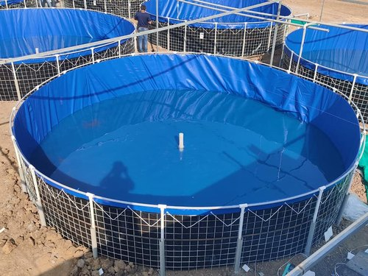
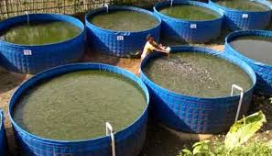
Scheme | Amount/nature of support provided
Name of Scheme | Units (No./ Ha.) | unit Cost (Rs.) | General (40% financial assistance) | ST/SC/Women (60% financial assistance)
Construction of Biofloc ponds for Brackish water/Saline/ Alkaline areas including inputs of Rs 8 lakhs/Ha | 0.4 Ha | 18 lakhs per 0.1 ha | 7.20 lakhs | 10.80 lakhs
Construction of Biofloc ponds for Fresh water areas including inputs of Rs 4lakhs/Ha | 0.4 Ha | 14 lakhs per 0.1 ha | 5.60 lakhs | 8.40 lakhs

Slide 9
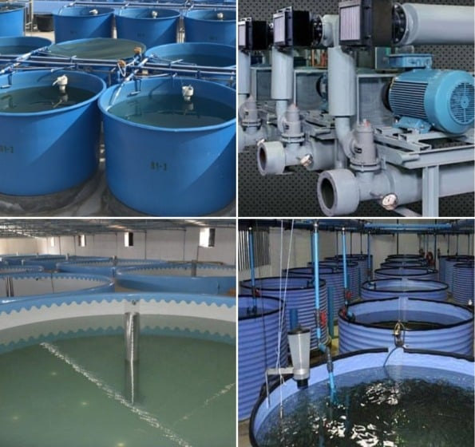
Scheme | Amount/nature of support provided
Name of Scheme | Units (No./ Ha.) | unit Cost (Rs.) | General (40% financial assistance) | ST/SC/Women (60% financial assistance)
Establishment of Medium RAS (with 6 tank of minimum 30m3/tank capacity 10ton/crop)/ Biofloc culture system (25 tanks of 4m dia and 1.m high) | 1 | 25 lakh | 10.00 lakh | 15.0 lakhs
Establishment of small RAS (with 1 tank of minimum 100m capacity / Biofloc (7 tanks of 4m dia and 1.5 high) culture system | 1 | 7.5 lakhs | 3.00 Lakhs | 4.50 lakhs

Slide 10
Scheme | Amount/nature of support provided
 | General | ST/SC/Women
Construction of Biofloc ponds for Brackish water/Saline/ Alkaline areas including inputs of Rs 8 lakhs/0.1Ha | Financial assistance of 40% will be granted limited to unit cost of Rs. 18 lakhs/0.1Ha. | Financial assistance of 60% will be granted limited to unit cost of Rs. 18 lakhs/0.1Ha
Construction of Biofloc ponds for Fresh water areas including inputs of Rs 4lakhs/0.1 Ha | Financial assistance of 40% will be granted limited to unit cost of Rs. 14 lakhs/0.1Ha. | Financial assistance of 60% will be granted limited to unit cost of Rs. 14 lakhs/0.1Ha

Slide 11
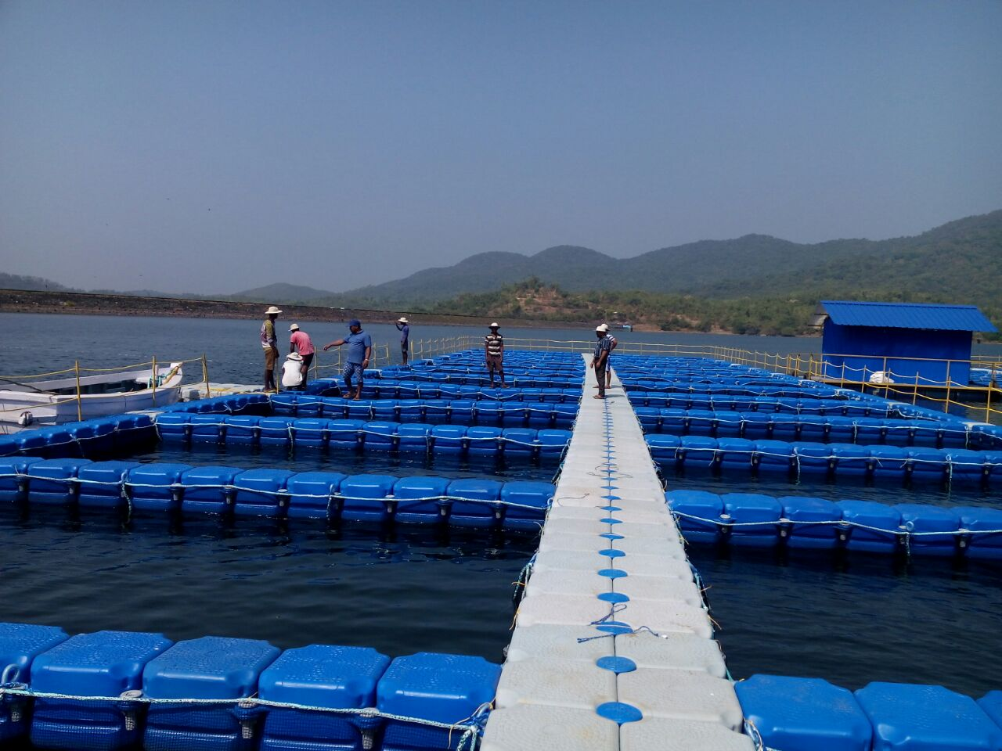
Scheme | Amount/nature of support provided
Name of Scheme | Units (No./ Ha.) | unit Cost (Rs.) | General (40% financial assistance) | ST/SC/Women (60% financial assistance)
Installation of Cages in Reservoirs | 40 | 3.00 Lakh | 1.20 lakhs | 1.80 lakhs

Slide 12
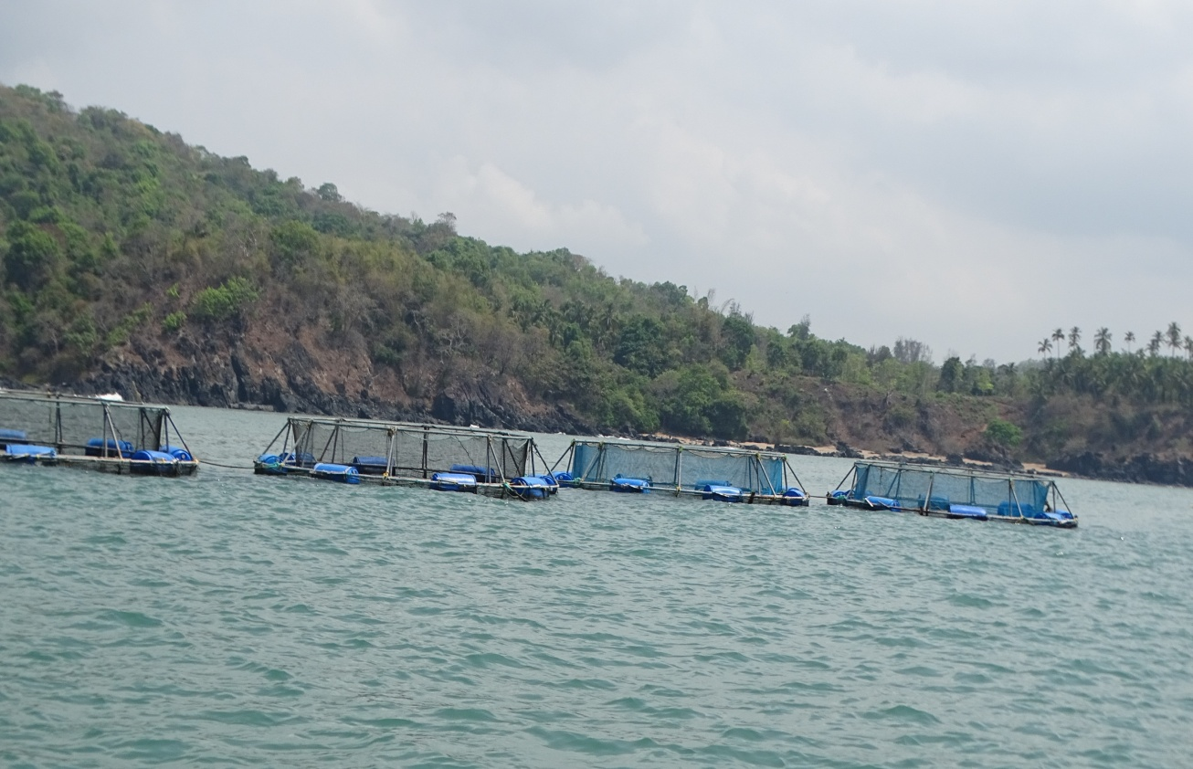
Scheme | Amount/nature of support provided
Name of Scheme | Units (No./ Ha.) | unit Cost (Rs.) | General (40% financial assistance) | ST/SC/Women (60% financial assistance)
Establishment of Open Sea cages (100-120 cubic meter volume) | 40 | 5 lakhs | 2.0 lakhs | 3.0 lakhs

Slide 13
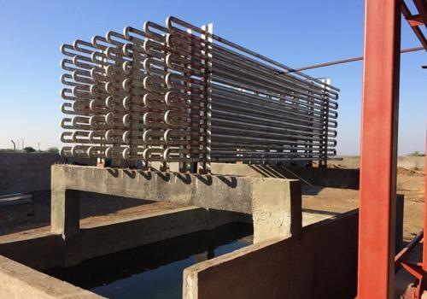
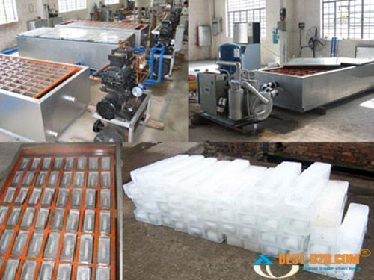
Scheme | Amount/nature of support provided
Name of Scheme | Units (No./ Ha.) | unit Cost (Rs.) | General (40% financial assistance) | ST/SC/Women (60% financial assistance)
Ice Plant /Storage of minimum 10 tonne | 1 | 40 lakhs. | 16.0 lakhs | 24.0 lakhs
Ice Plant /Storage of minimum 20 tonne | 2 | 80 lakhs | 32.0 lakhs | 48.0 lakhs
Documents Required Residence Certificate of 15 years Aadhaar Card SC/ST Certificate (if applicable) Quotation of Ice Plant/Cold Storage Detail Project Proposal Engineering Layout Survey Plan Form I & XIV Sale Deed/ Lease Deed Registration Detail (if any) NOC from Pollution Control Board Approval Letter of Power Load Water Source Letter from Bank to avail loan (if applicable) Mandate form (2 copies)

Slide 14
Scheme | Amount/nature of support provided
Name of Scheme | Units (No./ Ha.) | unit Cost (Rs.) | General (40% financial assistance) | ST/SC/Women (60% financial assistance)
Modernization of cold storage / ice plant | 2 | 50 lakhs | 20.0 lakhs | 30.0 lakhs
Documents Required Residence Certificate of 15 years Aadhaar Card SC/ST Certificate (if applicable) Quotation of Ice Plant/Cold Storage Detail Project Proposal Engineering Layout Survey Plan Form I & XIV Sale Deed/ Lease Deed Registration Detail (if any) NOC from Pollution Control Board Approval Letter of Power Load Water Source Letter from Bank to avail loan (if applicable) Mandate form (2 copies)

Slide 15
Individual Development and Self Sustaining Schemes

Slide 16
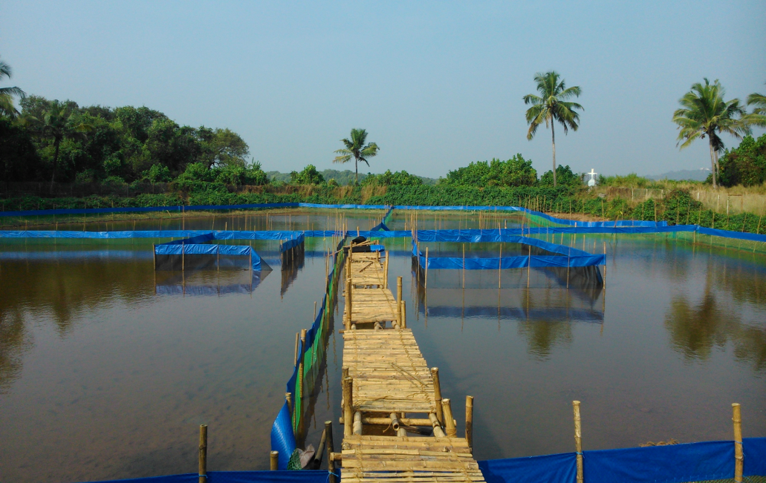
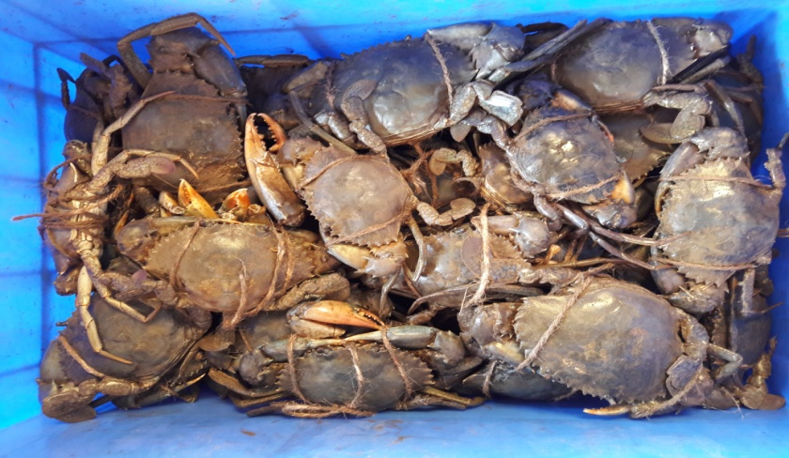
Scheme | Quantum of Assistance
9.Financial Assistance for setting up of Crab farming Unit in Goa | Financial assistance for setting up of the crab culture unit 25% of the actual cost limited to Rs. 1,50,000/-, per ha. Farmer will be eligible upto 2 ha. Financial assistance for purchase of Seed and feed: 50% of the actual cost limited to Rs. 75,000/- per ha., limited to 2 ha. area.
Application in prescribed form, Joint Photograph of applicant with his/her spouse.
Survey Plan showing neighboring area in original, Engineering layout, Project Report, Affidavit, Form I&XIV of the proposed land, N.O.C. from local Panchayat.
Proof of existence of the farm in case the farm is a existing as the traditional farm.
Ownership/leased document.
Residence Certificate of 15 years in Goa.
Training completion certificate of crab farming from Directorate of Fisheries/MPEDA/ ICAR/ any other Institute.
Mandate Form.

Slide 17
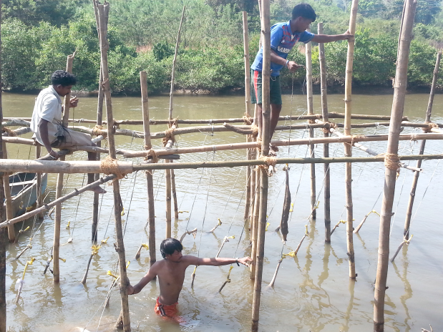
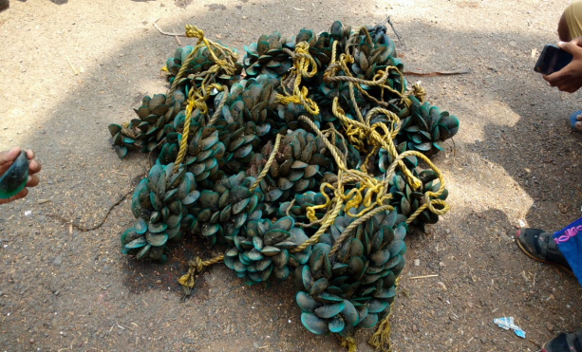
Scheme | Amount/nature of support provided
Name of Scheme | Units (No./ Ha.) | unit Cost (Rs.) | General (40% financial assistance) | ST/SC/Women (60% financial assistance)
Bivalve cultivation (mussels, clams, pearl etc.) | 10 | 20 thousand | 8 thousand | 12 thousand
Documents Required 15 years Residence Certificate of applicant Aadhaar Card SC/ST Certificate (if applicable) NOC from Captain of Ports Letter from Bank (if applicable) Detailed Project Report Quotation/ Cost Estimates Design/Layout Mandate form (2 copies)

Slide 18
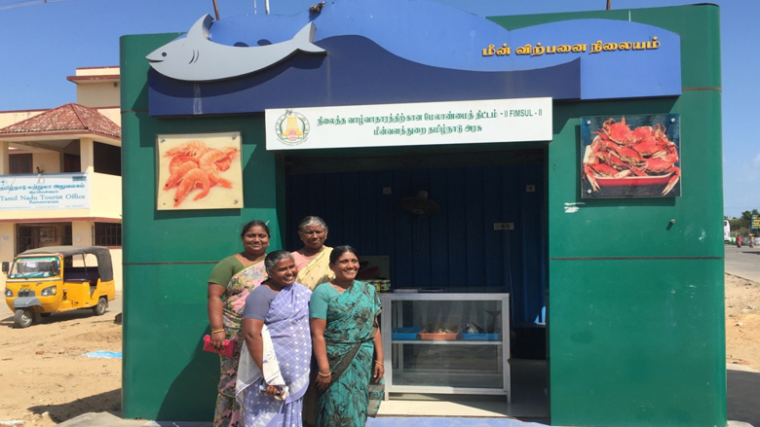
Scheme | Amount/nature of support provided
Name of Scheme | Units (No./ Ha.) | unit Cost (Rs.) | General (40% financial assistance) | ST/SC/Women (60% financial assistance)
19.Construction of fish kiosks including kiosks of aquarium/ ornamental fish | 8 | 10 lakhs. | 4.0 lakhs | 6.0 lakhs
Documents Required Residence Certificate of 15 years Aadhaar Card SC/ST Certificate (if applicable) Quotation of Fish Kiosk Detail Project Proposal Engineering Layout Survey Plan Form I & XIV Sale Deed/ Lease Deed Registration Detail (if any) Letter from Bank to avail loan (if applicable) Mandate form (2 copies)

Slide 19
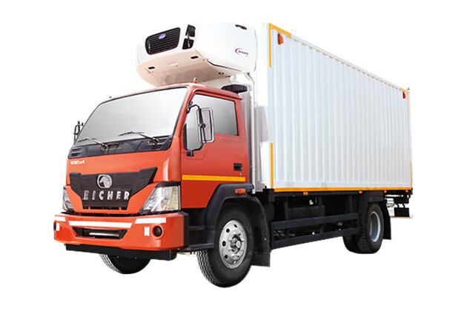
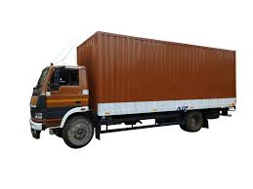
Scheme | Amount/nature of support provided
Name of Scheme | Units (No./ Ha.) | unit Cost (Rs.) | General (40% financial assistance) | ST/SC/Women (60% financial assistance)
Refrigerated vehicles | 4 | 25 lakhs | 10.0 lakhs | 15.00 lakhs
Insulated vehicles | 10 | 20 lakhs | 8.0 lakhs | 12.00 lakhs

Slide 20
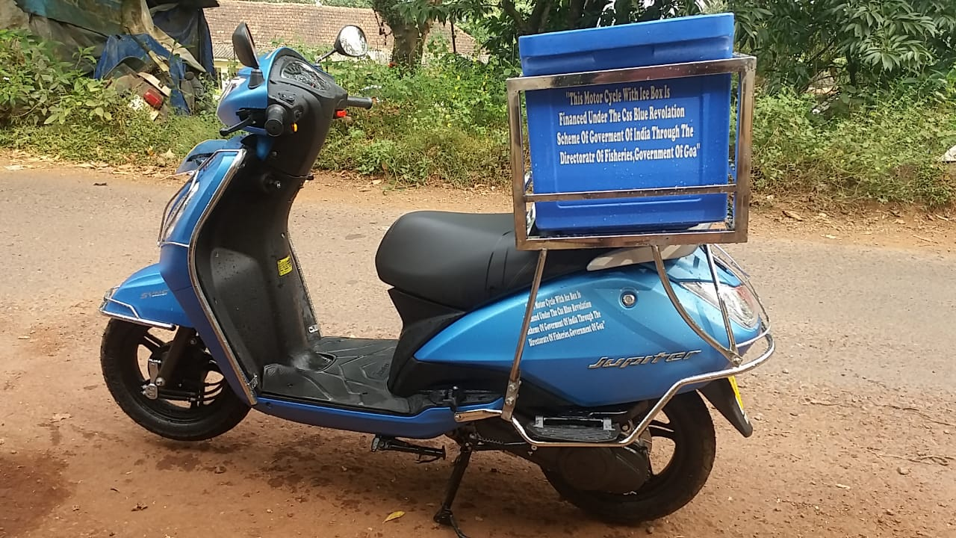
Scheme | Amount/nature of support provided
Name of Scheme | Units (No./ Ha.) | unit Cost (Rs.) | General (40% financial assistance) | ST/SC/Women (60% financial assistance)
15.Motor Cycle with Ice Box | 10 | 0.75 lakhs | 0.30 lakhs | 0.45 lakhs
Documents Required Residence Certificate of 15 years Aadhaar Card SC/ST Certificate (if applicable) Certificate from Village Panchayat/Municipality indicating that applicant is actively engaged in sale of fish Letter from Bank (if applicable) Driving Licence (2 wheeler) Quotation Mandate form (2 copies)

Slide 21
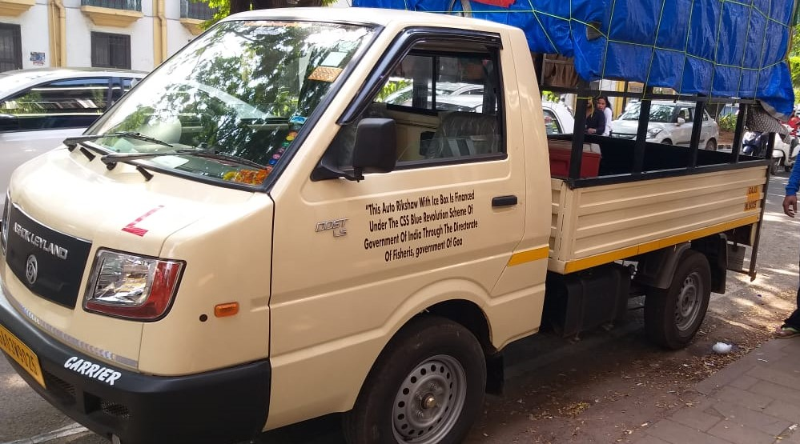
Scheme | Amount/nature of support provided
Name of Scheme | Units (No./ Ha.) | unit Cost (Rs.) | General (40% financial assistance) | ST/SC/Women (60% financial assistance)
16.Three wheelers with ice box including e- rickshaw for fish vending | 10 | 3 lakhs | 1.20 lakhs | 1.80 lakhs
Documents Required Residence Certificate of 15 years Aadhaar Card SC/ST Certificate(if applicable) Certificate from Village Panchayat/ Municipality indicating that applicant is actively engaged in sale of fish Letter from Bank (if applicable) Driving Licence (4 wheeler) Quotation Mandate form (2 copies)

Slide 22
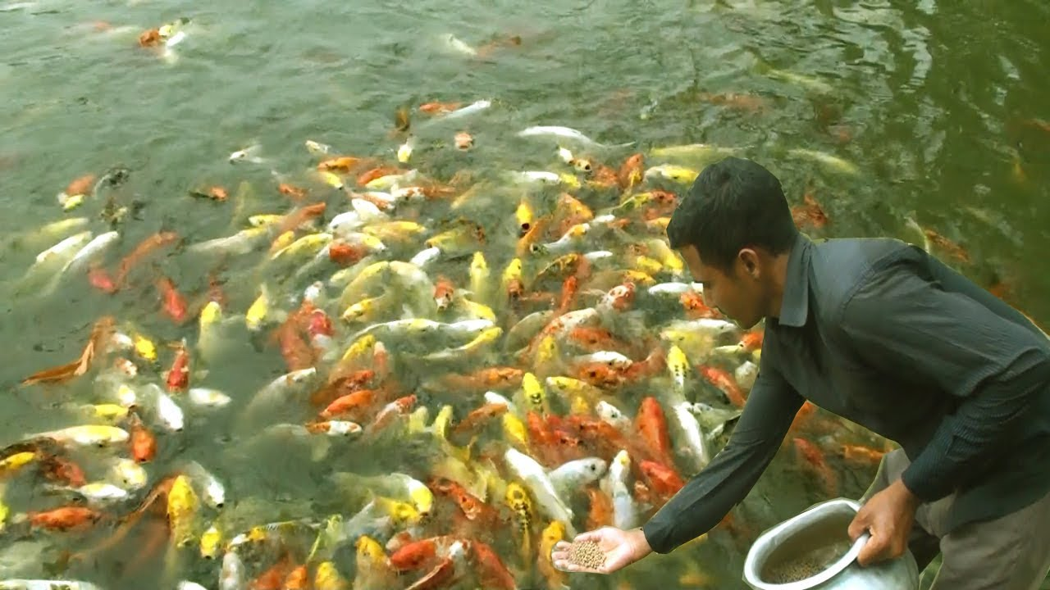
Scheme | Amount/nature of support provided
 | General | ST/SC/Women
Backyard Ornamental fish Rearing unit (both Marine and Fresh Water) | Financial assistance of 40% will be granted limited to unit cost of Rs. 3 lakh | Financial assistance of 60% will be granted limited to unit cost of Rs. 3 lakh
Documents Required 15 years Residence Certificate of applicant Aadhaar Card Land Documents SC/ST Certificate (if applicable) Detailed Project Report Quotation/ Cost Estimates Mandate form

Slide 23
SHG’s and Woman Empowerment

Slide 24
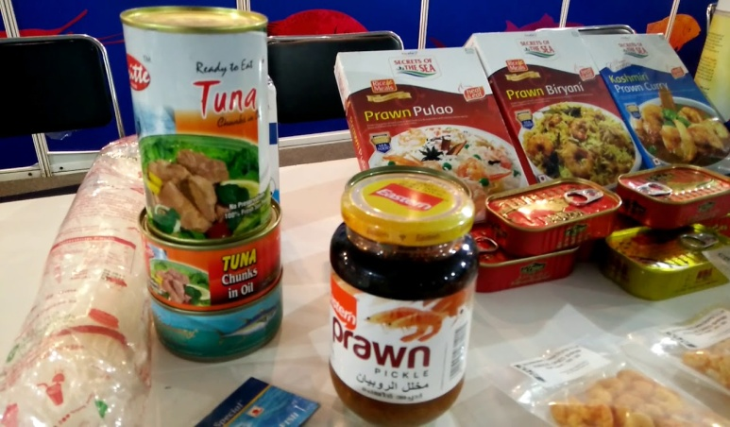
Scheme | Amount/nature of support provided
Name of Scheme | Units (No./ Ha.) | unit Cost (Rs.) | General (40% financial assistance) | ST/SC/Women (60% financial assistance)
18. Fish Value Add Enterprises Units | 1 | 50 lakhs | 20 Lakhs | 30 lakhs
Documents Required Residence Certificate of 15 years Aadhaar Card SC/ST Certificate (if applicable) Lease Deed/Sale Deed of Unit Registration of Enterprise Cost Estimates/Quotations Project Report

Slide 25
Fishermen Development Schemes

Slide 26
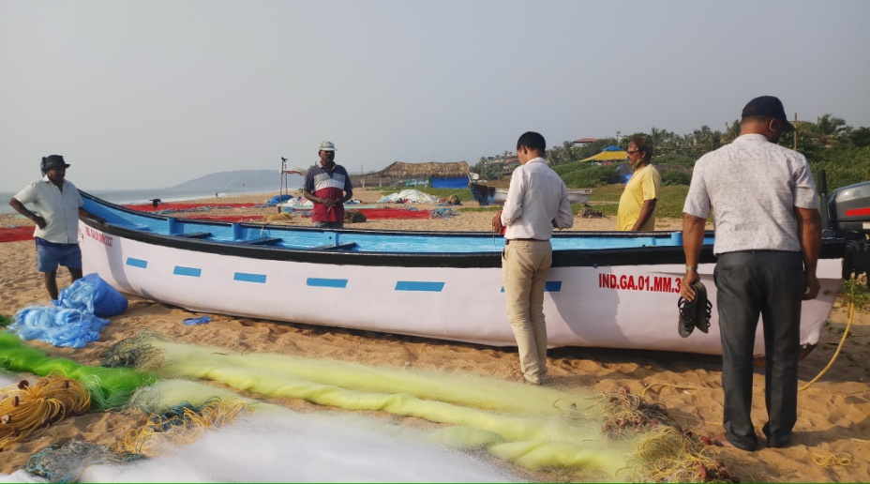
Scheme | Quantum of Assistance
5. Financial Assistance For Construction /Purchase Of F.R.P. / Wooden Fishing Crafts | General category 50% subsidy limited to Rs.60,000/- and for SC/ST 50% subsidy limited to Rs.80,000/-
Documents Required Application in prescribed form along with the Joint Photograph of the applicant along with spouse. Self declaration Vessel Registration Certificate Fishing vessel license Net License Invoices Inspection Report Mandate form (2 copies) SC/ST Certificate (if applicable) Aadhar Card

Slide 27
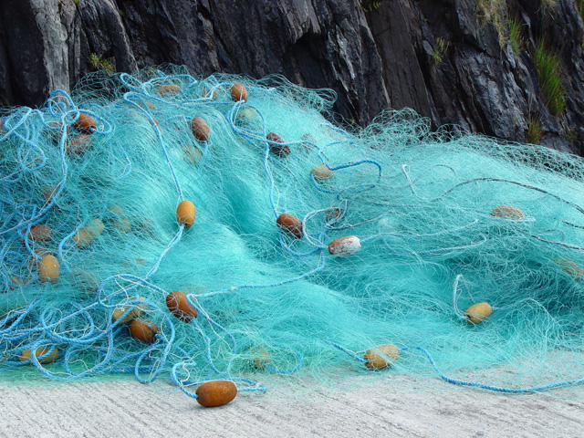
Scheme | Quantum of Assistance
3. Financial Assistance To Fishermen For Purchase Of Fisheries Requisites (Gill Nets With Accessories) | General category 50% subsidy limited to Rs.30,000/- and for SC/ST 50% subsidy limited to Rs.40,000/-
Documents Required Application in prescribed form along with the Joint Photograph of the applicant along with spouse. Self declaration Vessel Registration Certificate Fishing vessel license Net License Invoices Inspection report Mandate form (2 copies) SC/ST Certificate (if applicable) Aadhar Card

Slide 28
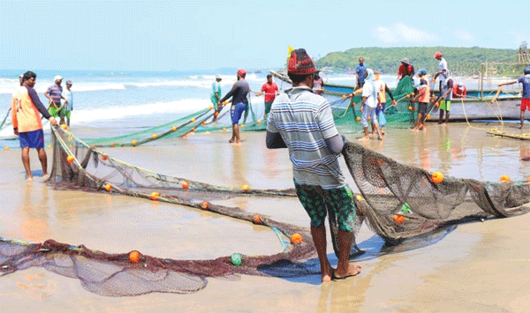
Scheme | Quantum of Assistance
4. Financial Assistance To Purchase Singel Net / Small Rampon Net & Its Accessories | Subsidy 50% of the actual cost limited to Rs.50,000/- (Rupees Fifty Thousand only) . Traditional fishermen will be entitled to avail the same after every five years
Documents Required Application in prescribed form Quotation Birth Certificate OBC (Kharvi) certificate 15 years residence certificate Adhar Card copy Mandate form along with bank passbook copy (2 copies) Bank letter (if applicable)

Slide 29
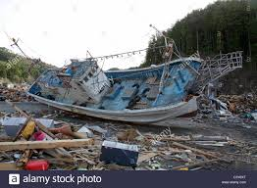
Scheme | Quantum of Assistance
11.Natural Calamity Relief To Fishermen | All active fishermen who contribute to the Fishermen Corpus Relief Fund whose fishing vessels including engine, Motors, fishing vessels are damaged or lost due to natural calamity like floods, cyclone, Tsunami, accidental fire shall be eligible for financial assistance
Documents Required Application in prescribed form alongwith Photograph of the applicant Vessel Registration Certificate Latest Receipt of Net/vessel Licence Biometric Card copy/ temporary I-Card Joint site inspection report of Registered canoe/ OBM/ Medical certificate/Panchanama report/Post mortem report/ missing report Mandate form.

Slide 30
Scheme | Amount/nature of support provided
 | General | ST/SC/Women
Support for acquisition of Deep sea fishing vessels for traditional fishermen | Financial assistance of 40% will be granted limited to unit cost of Rs. 120 lakhs | Financial assistance of 60% will be granted limited to unit cost of Rs. 120 lakhs.
Documents Required Only traditional/ artisanal fishermen and their societies/associations/ SHGs/ FFPOs are eligible. Beneficiary should possess valid ownership certificate, Registration certificate under the ReALCraft, fishing license and Biometric ID cards of fishers/QR coded Aadhar card The governmental assistance is restricted to (a) 1 unit per individual beneficiary, (b) 2 units per group/society (of at least 10 members) in case of Groups of traditional/artisanal fishermen i.e. traditional/artisanal fishermen SHGs/Joint Liability Groups (JLGs)/ traditional/artisanal Fisher Cooperatives etc. or those undertaken in a cluster/area approach. The vessel should have onboard machineries/fishing equipment including refrigerated storage facilities for undertaking deep sea tuna long lining and gill netting. Appropriate communication systems, AIS/transponders and other navigational equipment for safe navigation etc., as per the relevant regulations/guidelines are mandatory onboard the vessels Deep sea fishing vessel should be considered as an alternative for replacement of the existing bottom trawler and the State/UT shall ensure suitable disposal of old fishing boat (against which new one is replaced). Beneficiaries will submit Self- Contained Proposal (SCP) with relevant techno-financial details of the vessel.

Slide 31
Scheme | Amount/nature of support provided
 | General | ST/SC/Women
Up gradation of existing fishing vessels for export Competency | Financial assistance of 40% will be granted limited to unit cost of Rs. 15 lakhs | Financial assistance of 60% will be granted limited to unit cost of Rs. 15 lakhs
Documents Required The fishing vessels identified for up-gradation should possess valid ownership certificate, Registration certificate and fishing license under the ReAL Craft and the owners/crew members should possess the valid Biometric ID cards/QR Coded Aadhar Card. The vessel should be operational condition and not outlived its life span and fit for undertaking up-gradation work required for its export competency or conversion and capable of doing resource specific deep-sea fishing (including tuna long lining) after up-gradation/conversion. The up-gradation work for export competency of the vessel may inter alia include (a) Assistance for insulated fish hold, including those with mechanical slide door system,(b) Insulated Fish boxes, (c) Slurry ice making machine/Refrigerated Sea Water (RSW), (d) setting up of Bio Toilet, (e) Fiber Reinforced Plastic (FRP) sheathing on the wooden deck. And (f) any other need based activity to improve export competitiveness. The Beneficiaries will ensure utilization of the Governmental assistance strictly for the purpose for which it has been sanctioned. The vessels which have already converted/upgraded or availed assistance under previous or ongoing scheme of the Government shall not be eligible for the subsidy under this component.

Slide 32
Scheme | Amount/nature of support provided
 | General | ST/SC/Women
Establishment of Bio-toilets in mechanized fishing vessels | Financial assistance of 40% will be granted limited to unit cost of Rs. 0.50 lakhs | Financial assistance of 60% will be granted limited to unit cost of Rs. 0.50 lakhs
Documents Required QR Coded Aadhar Card copy of beneficiaries and Crew members ST/SC Certificate (if applicable) Mandate form along with bank pass book (02 copies) Vessel Registration Certificate Fishing Vessel Licence Invoice towards purchase of Bio Toilet Photograph of Bio toilet installed on Fishing Vessel

Slide 33
Scheme | Amount/nature of support provided
 | General | ST/SC/Women
Providing boats(Replacement) and nets for traditional fishermen | Financial assistance of 40% will be granted limited to unit cost of Rs. 5 lakhs | Financial assistance of 60% will be granted limited to unit cost of Rs. 5 lakhs
Documents Required QR Coded Aadhar Card copy of beneficiaries and Crew members ST/SC Certificate (if applicable) Mandate form along with bank pass book (02 copies) Vessel Registration Certificate Fishing Vessel Licence Net Licence Undertaking as per performa Invoice towards purchase/Construction of new FRP and Net

Slide 34
Scheme | Quantum of Assistance
Goa Value Added Tax based subsidy on H. S. D. Oil consumed by Fishing Vessels Scheme. | (1) An amount equivalent to the actual Value Added Tax paid shall be reimbursed to the owner of fishing vessel eligible under this Scheme as subsidy, on H.S.D. Oil consumed by fishing vessel used for the purpose of fishing on limited quota as decide by Government. (2) The total quota of H.S.D. Oil for the purpose of this Scheme shall be restricted to 20,000 K.L. per financial year for the entire fishing industry.
Documents Required a) Statement of HSD Oil consumed (b) Invoice of HSD oil (c) Bills of HSD oil (d) VRC copy (e) Fish catch data (f) Fishing vessel Licence Certificate (g) Fishing Net Licence Book (h)Fishermen Corpus Fund Form duly filled Report on VAT charged on HSD Oil by the Oil company

Slide 35

Scheme | Quantum of Assistance
10.Interest Subsidy on Loans for Agriculture and Allied Activities | Loan upto Rs.5.00 lakhs and below is provided to the beneficiaries in fisheries sector.
Documents Required 1. Quotation 2.Aadhaar Card 3.VRC 4. Fishing &Net License receipts 5.Letter from bank to avail Loan 6. Inspection Report from F.O. 7.Mandate form

Slide 36
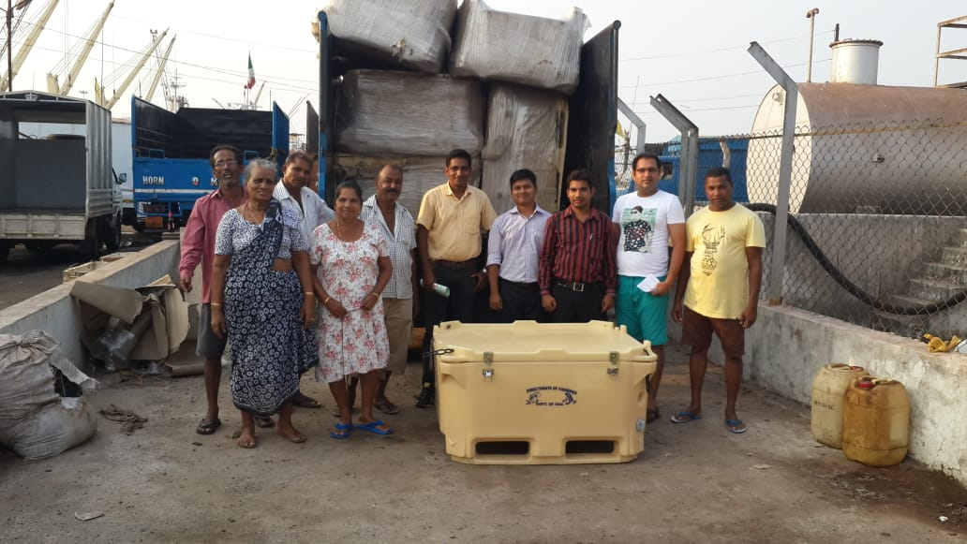
Scheme | Quantum of Assistance
6. Supply of Insulated Boxes | i) The applicant engaged in selling/marketing of fish will be eligible for 1 insulated box of 50 litres capacity and will be entitled for subsidy to the extent of 75% of the cost limited to Rs. 1500/-. ii) The applicant actively engaged in fishing at sea with canoe will be eligible for one insulated box of 100 litres and one box of 220 litres capacity and subsidy to the extent of 75% of the cost limited to Rs. 7,000/- respectively. iii) The applicant engaged in fishing at sea with mechanized fishing vessel upto 6 cylinder engine will be eligible for 1 insulated box of 220 litres and and 1 insulated box of 400 litres. capacity and subsidy to the extent of 75% of the cost limited to Rs. 15,000/- respectively.
Documents Required For 50 litres capacity Insulated boxes for active fish sellers. Certificate from village Panchayat / Municipality indicating that applicant is actively engaged in retail sale of fish. Copy of Aadhaar card. For 220 litres capacity Insulated boxes for fishing vessels. Copy of VRC of Fishing Vessel. Latest copy of receipt of Fishing licence fees paid. Latest copy of receipt of Net licence fees paid. Copy of Aadhar Card Copy of Sea Worthiness Certificate issued by Captain of Port. For 100 litres capacity Insulated boxes for fishing canoes. All as above no. 1from a to d except e.

Slide 37
Scheme | Amount/nature of support provided
 | General | ST/SC/Women
Construction of fish retail markets including ornamental fish /aquarium Markets | Financial assistance of 40% will be granted limited to unit cost of Rs. 100 lakhs
Documents Required Beneficiaries will submit Detailed Project Report (DPR) with justification, detailed cost estimate, recurring cost involved, source of funds for meeting the beneficiary contribution including bank consent for providing loan, undertaking of beneficiary to the effect that no other governmental assistance is availed for the proposed project, anticipated direct & indirect employment generation to local population, and specific time lines for completion of the project etc. Beneficiaries will provide documentary evidence of availability of requisite land (either own/registered lease), necessary clearances/ permissions from the concerned State/UT/authority as may be required. In case of lease land, the minimum lease period should be 10 years from the date of submission of DPR/SCP and the registered lease document will be included in the DPR/SCP.

Slide 38
Other Schemes and Services
Services
KCC for Fishermen
Registration of Fish Sellers
Integrated models for fish Culture
  Duck-cum-fish culture
  Pig-cum-fish culture
  Poultry-cum-fish culture
  Aquaponics

Slide 39
Skill Development
Six months training Course
Short Term trainings
Training Course at CIFNET, Cochin
  Vessel navigator course: - Duration of course 24 months.
  Marine Fitter Course: - Duration of course 24 months.
B.Sc. (Fisheries) at Dr. Balasaheb Sawant, Konkan Krishi Vidhyapeet, Dapoli, Ratnagiri District, Maharashtra
Demonstration farms
  Brackishwater farm at Old Goa
  Fresh water farm at Kerim-Anjunem

Slide 40
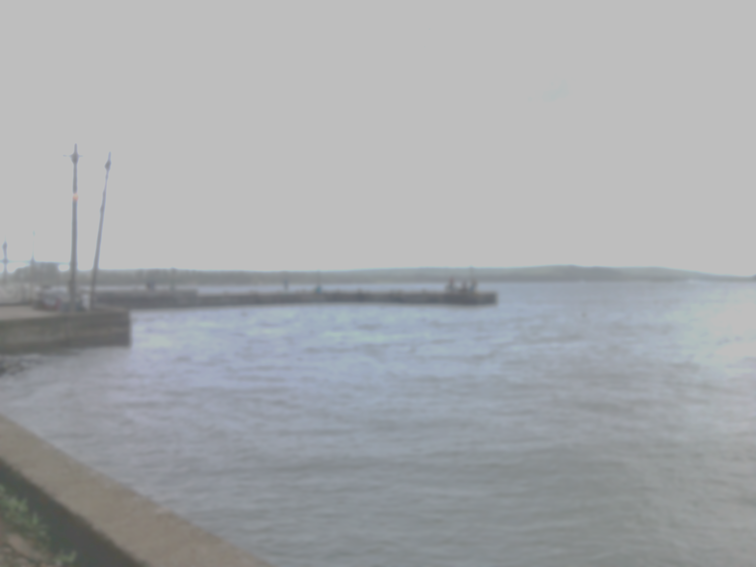

For more information………….
Directorate of Fisheries
Government of Goa
Dayanand Bandodkar Marg, Panaji Goa.
Tel: (O) 2224838
Fax: (0832)2231049
Email: dir-fish.goa@nic.in.
Website: www.fisheries.goa.gov.in

Slide 41
List of Officials
Name of the Official | Place of Posting | Contact No.
Shri. Vipul Mhapari | Pernem Block and Chapora jetty | 7972249123
Shri. Uday Khanolkar | Bardez & Bicholim Block | 9049238965
Dr. Ruchita Vernekar | Tiswadi Block | 9923257389
Shri. Shubam Majik | Mormugao Block | 8766924001
Smt. Akshata Naik | Salcete & Quepem Block | 9637997994
Shri. Joel Diniz | Cancona & Sanguem Block | 9923972603
Shri. Diwakar Korgaonkar | Ponda & Sattari Block | 9423837493
Shri. Alec D’Souza | Malim Jetty | 9604033152
Shri. Seby Moraes | Vasco Jetty | 9309579901
Shri. Udaykumar Gaonkar | Cutbona Jetty | 9579757821
Beside above officers, Department has placed Sagar Mitras in every block and Panchayat, who can be contacted for more details regarding the schemes and services.

Slide 42
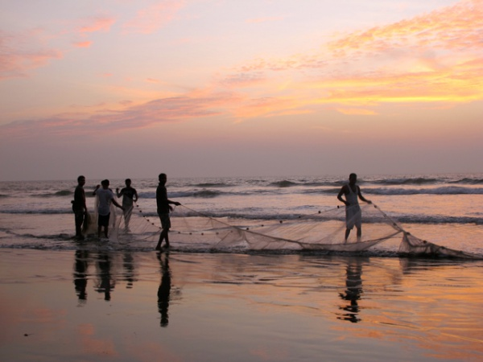
Thank you

