Slide 1
Directorate of Women & Child Development
Presented by
Mrs. Gauri U. Parob
Child Dev. Project Officer

Slide 2
Various schemes of DWCD
Central Schemes
Integrated Child Development Scheme (ICDS) Renamed as Anganwadi Services Scheme (ASS)
Beti Bachao Beti Padao Scheme (BBBP)
Pradhan Mantri Matru Vandana Yojana (PMMVY)
State Schemes
Ghriha Aadhaar
Laadli Laxmi
Mamta
Swalambhan Scheme

Slide 3
Central Schemes

Slide 4
Integrated Child Development Scheme (ICDS) Renamed as Anganwadi Services Scheme (ASS)
Integrated Child Development Services (ICDS) is a centrally sponsored scheme started in the year 1978-79.
Under this scheme the Anganwadi centers have been set up in all the rural and urban areas of the State. At present there are 1262 Anganwadi Centers sanctioned by the Central Government, out of which 1261 are operational.
The timings of the Anganwadi centers are from 8.30 a.m to 12.30 pm on all the days except Sundays, second Saturdays and public holidays.

Slide 5
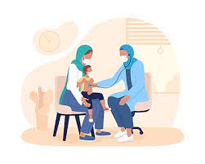
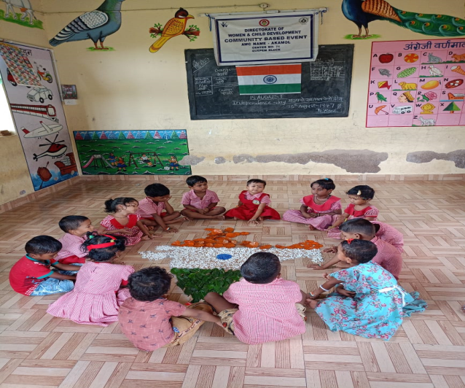
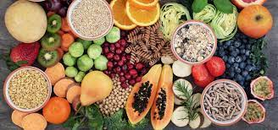
There is no bar or any condition for enrolling a child of 0-6 years at the Anganwadi Centre.
Under ICDS Scheme, the Anganwadi Centers provide 6 services at each of the Centers, which are as follows:
Immunization
Health checkup
Referral services
Supplementary nutrition
Nutrition and health education
Non-formal pre-school education.

Slide 6
Out of these above six services under ICDS, the most important service is the Supplementary Nutrition Programme (SNP) .
Under the Supplementary Nutrition Programme (SNP) dry take - home packets of cereals and pulses are provided to pregnant women and nursing mothers at the rate of Rs 17.50 per day.
Under this scheme children in the age group of 6 months to 3 years at the rate of Rs. 13.00 per day.
Malnourished children are given more attention, they are referred to government hospitals and they are also provided with dry packets or cooked meals at the rate of Rs. 21.00 per day.
The Anganwadi children (3-6 yrs of age) are provided hot cooked nashta at the AWC and children (6 months - 6 years) & pregnant / lactating mothers are provided with take home ration in form of ready to cook pre-mixed.

Slide 7
Beti Bachao Beti Padao Scheme (BBBP)
Beti Bachao Beti Padao Scheme is a Central Scheme launched by the Honorable Prime Minister Shri. Narendra Modi on 22nd January 2015 at Panipat in Haryana.
The BBBP scheme was launched and implemented by Government of Goa on 6th May 2015 in the North District of the State of Goa. Now, the Scheme is also implemented in South Goa District.
Beti Bachao Beti Padao Scheme is a Central Sector Schemes (CSS), implemented through State Governments through District Collectors/District Magistrates.

Slide 8
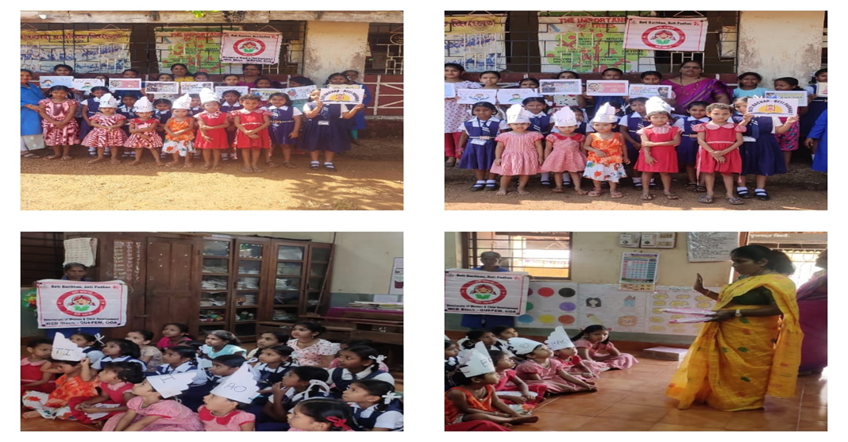
The main aim of the Scheme is as follows:-
1) Preventing gender biased sex selective elimination.
2) Ensuring survival and protection of girl child.
3) Ensuring education and participation of the girl child
South District has been selected by the Government of India for “only Media Advocacy Outreach”.

Slide 9
South District has been selected by the Government of India for “only Media Advocacy Outreach”.

Slide 10
Pradhan Mantri Matru Vandana Yojana (PMMVY)
Pradhan Mantri Matru Vandana Yojana is a maternity benefit program run by the government of India. It is a Direct Benefit Transfer Scheme for pregnant and lactating women of 19 years of age or above for the two live birth.
But except those employed by the State Government, Central Government, or Public Sector Undertakings, and those already receiving similar benefits under another applicable law.

Slide 11
Revised PMMVY Guidelines
The benefit is available to a women for the first 2 living children provided the second child is a girl child.
In case of the first the amount of Rs. 5000/- in two installments and for the second child , the benefit of Rs. 6000/- will be provided, the second child is a girl child in single installment after the birth.

Slide 12
State Schemes

Slide 13
Ghriha Aadhaar
The objective of the scheme is to address the problem of spiraling prices and to provide support to the housewives/homemakers from middle, lower middle and poor section of the society, to maintain a reasonable standard of living for their families.
Under this scheme a monthly Rs. 1500/- is transferred every month directly to the housewives/homemakers to achieve the objective.

Slide 14
Eligibility and other conditions
Any married woman above the age of 18 years, who fulfills all of the following conditions, is eligible to apply:
(i) She should be a resident of Goa for the last fifteen years.
(ii) The gross income of the husband and wife, taken together should not exceed Rs.3, 00, 000/- per annum.

Slide 15
Provided, that the beneficiary or the husband should not be in receipt of the benefit under the Dayanand Social Security Scheme (DSSS) of the Directorate of Social Welfare, Government of Goa.
However, a widow having a child living shall be eligible for benefit under this scheme, even though she is a beneficiary of the DSSS till the child attains 18 years of age.

Slide 16
The application shall be enclosed with the following documents
1. Self attested copy of Marriage certificate issued by the competent authority.
2. Self attested copy of 15 years Residence Certificate issued by Taluka Mamlatdar.
3. Proof of present residential address (includes Election Photo Identity Card – EPIC or any such document which establishes the present address.).
4. Attested copy of Birth certificate along with one year residence certificate of the applicant and Birth certificate along with 15 years Residence certificate of her husband (in case of applicant who is originally native from outside the State and has married to a person of Goan origin).

Slide 17
5. Attested copy of Aadhaar card.
6. Income Certificate issued by the Competent authority (i.e. Secretary, Village Panchayat/ Chief Officer, Municipal Council).
7. Attested copy of savings bank account pass book with IFSC & MICR details (The bank account submitted should be preferably Aadhaar linked for DBT (Direct Benefit Transfer) purpose.).
8. Birth certificate of the child along with life certificates. (in case of widow who is a DSSS beneficiary).

Slide 18
Laadli Laxmi
Laadli Laxmi Scheme was launched on 06/07/2012 as one of the flagship programs of the State Government with an intention to address the undesirable tendency of female foeticides and with a aim towards erasing the general perception that the birth of a girl in the family is the burden on her parents/guardian during her marriage.

Slide 19
Financial Assistance
The beneficiaries under this scheme are paid Rs. 1.00 lakh as financial assistance provided they fulfill the criteria therein in the below mentioned
On attaining the age of 18 upto 45 years.
The beneficiaries on attaining the age of 18 years are paid Rs. 1.00 lakh as financial assistance by means of bank fixed deposit jointly in the name of the Director of Women and Child Development and the applicant (the Girl).
The beneficiaries on the occasion of marriage are paid cash through the Bank.

Slide 20
Eligibility criteria
Any Girl who fulfils all of the following conditions is eligible apply:
(a) born in the State of Goa;
(b) resident of Goa for the last fifteen years; and
(c) (i) whose at least one of the parents is born in Goa and is also a resident of Goa for the last fifteen years; or
(ii) whose one of the parents is residing in Goa for last twenty five years;
(iii) whose parental income does not exceed Rs. 3.00 lakh per annum.
(B) Provided that a Girl, who is born outside Goa, shall be eligible if she is:
(a) resident of Goa for the last fifteen years;
(b) educated in Goa; for a minimum period of 7 years (continuous); and
(c) (i) whose at least one of the parents is born in Goa and is also a resident of Goa for the last fifteen years; or
(ii) whose one of the parents is residing in Goa for last twenty five years.
(iii) whose parental income does not exceed Rs.3.00 lakh per annum

Slide 21
As per notification No.2-279-LL-2012-DW&CD/6805 dated 10/11/2022 publish in Official Gazette
The Applicants under the Laadli Laxmi Scheme shall be MARRIED APPLICANTS who are in the age group of 18 to 45 years.
The applications have to be submitted to the Directorate of Women & Child Dev. within six months from the date of Civil Marriage Registration.
Applicants who have registered their marriages before coming into force this amendment i.e. before 17/11/2022 will have to apply within one year from the date of Civil Marriage registration.
All the existing eligible applications of unmarried applicants pending at the Dept. on the date of issue of this notification shall be sanctioned after production of valid Civil Marriage Registration Certificate issued by the competent authority.

Slide 22
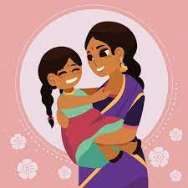
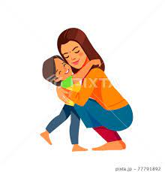
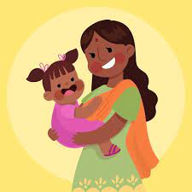
Mamta Scheme
One time Financial Incentives to Mothers who Deliver a Girl Child.
The Scheme is applicable to mother who deliver a live girl child (maximum 02 deliveries) in the registered medical institution.
Under the Scheme an amount of Rs. 10000/- shall be paid to all the mothers who delivers a girl child in the registered medical institution.

Slide 23
Eligibility Criteria
All mothers who deliver a live Girl Child (maximum 02 deliveries) in the registered medical institution.
The Scheme is available to all irrespective of their social /economical status.
The mother should be resident of Goa for at least three years or married to a resident of Goa.
The eligible mother who delivers a girl child shall apply to the Child Development Project Officer through the local Anganwadi Centre along with a copy of the Birth report/Birth Certificate in the prescribed form within 45 days of the delivery of the girl child.
The benefits are directly credited to the declared Bank Account.

Slide 24
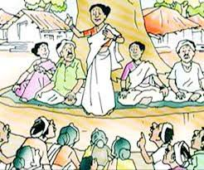
GRANT-IN-AID SCHEME TO PROVIDE FINANCIAL ASSISTANCE TO THE MAHILA MANDALS/WOMEN’S SELF HELP GROUPS (SWAWLAMBHAN)
The objective of the scheme is to provide financial assistance to Mahila Mandals/Self Help Groups for training/orientation for members of the Mahila Mandal/ Self Help Groups for generating their own activity for self-employment.

Slide 25
Pattern of Financial Assistance:
Each Mahila Mandal shall be disbursed following grants:
(1) Rs. 20000/- as annual Grant-in-Aid for registered Mahila Mandal/Women’s Self Help Group for successful functioning in the Goa State.
(2) Rs. 5000/- shall be sanctioned per course for purchase of raw materials to every Mahila Mandal for conducting any activity for self employment.
(3) Resource persons/ Master Trainers/Instructors may be provided by the Directorate for each course of activity through CDPO’s.
(4) An amount of Rs. 5000/- will be paid per course as fixed honorarium to the Master trainer/ instructor.
(5) Actual TA incurred by the Master Trainers/Instructors shall be paid if travelling in the Taluka outside his/her jurisdiction.

Slide 26
Eligibility:
Each Mahila Mandals/Women’s Self Help Groups shall fulfill following condition to avail the
Scheme of Grant-in-Aid and Financial Assistance.
(1) The Mahila Mandals/Women’s Self Help Groups should have valid registration with the Department of Women & Child Development, Panaji Goa.
(2) The Mahila Mandals/Women’s Self Help Groups shall be operating successfully for their members within the State of Goa.
(3) Each group shall submit the project reports specifying the activities/training and list of prospective beneficiaries with educational details.
(4) There shall be minimum 20 members for training & orientation.

Slide 27
Emergency Helpline number for Women - 181
The Department of Women and Child Development (Goa) has launched an emergency helpline number for Women - 181.
The universal free 24×7 helpline, 181, is a toll-free number to support women in need of counselling, guidance, information and also for rescue in various threatening situations, including domestic violence.

